Slide 1
Electrical Load Consumption Forecasting Using Machine Learning

Slide 2
Power System I Laboratory
Course No: EEE 306
Md. Rokonuzzaman Rokon - 1806180
Md. Meherab Hossain - 1806182
Md. Alamgir Hossain - 1806186
Asif Quadir - 1806187
Fahim Shahriar Talukder - 1806193

Slide 3
What is load forecasting?
Generation of Electricity depends on demand.
Essential for the electric power companies to estimate the load demand their distributing regions
This load estimation under various circumstances is usually referred to as load forecasting.

Slide 4

Necessity of Load Forecasting
Planning for the expansion of the power system begins with a prediction of expected future load requirements.
To reach decisions about the production and purchase of electricity, Switching loads, managing voltage, rearranging networks, and building infrastructure
For proper Grid formation
For proper Electrical sales
For the electricity system's effective planning.
In order to properly plan the transmission and distribution infrastructure.
For efficient power system performance.

Slide 5
Working Procedure
Dataset Collection
Dataset preparation and Selecting Features
Deploy the Model into Server and Create Web App
Checking Outliers and Correlation
Creating Train set, Validation Set and Test Set
Create ML Model with Appropriate Regression Algorithm
Testing Model Output with Validation and Test Set

Slide 6
Dataset Description
Entire Dataset was collected from Kaggle Competition and title was
“Hourly Energy Demand Generation and Weather”
This competition contains two individual dataset
Energy dataset: This dataset contains hourly electricity generation, demand and pricing information for years 2015 to 2018 of Spain (total 28 columns).
Weather features: This dataset contains hourly weather information like Temperature, Humidity, Windspeed, atmospheric pressure of five major cities of Spain.

Slide 7
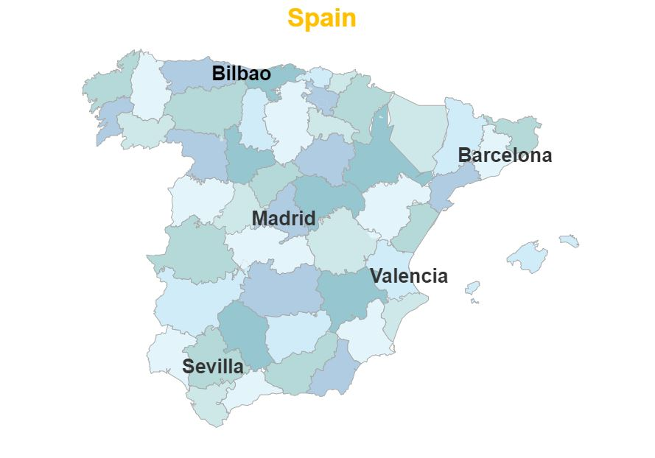
Dataset Description (cont.)
Five major cities were taken from five different regions to represent weather information of the whole country

Slide 8
Dataset Preparation
Removing duplicate data
Removing outliers and other preprocessing
Merging two dataset basis on hourly timestamp
Removing incomplete rows
After merging size of the dataset become 35064×89

Slide 9
Feature Selection
Required features selecting from the merged dataset
Select total load actual as our target column
As input selecting Day, Month, Year and Hour to represent time information
And temperature (K), atmospheric pressure (hPa), humidity (%) and wind speed (m/s) for each city to represent weather information
Now, we have 24 columns as input features and one as target.

Slide 10
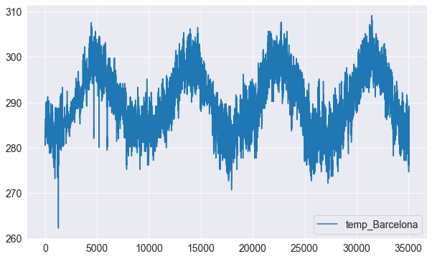
Checking Outliers
Selected features were examined to look for outliers and missing data
No outliers and missing data found

Slide 11
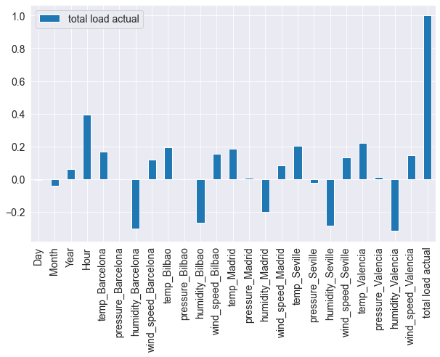
Checking Correlation
Correlation of total load actual with every selected features were examined

Slide 12
Dataset Splitting
Dividing dataset into three sets.
Training Set
Contains data from 2015 to 2017 (26305 data)
Validation Set
Contains data for first six months of 2018 (4415 data)
Test Set
Contains data for last six months of 2018 (4344 data)

Slide 13
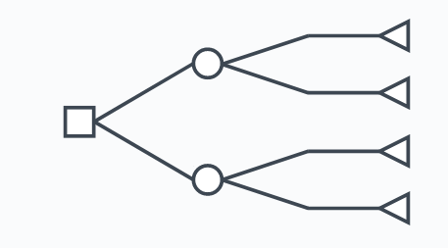
Machine Learning Algorithm
XGBoost Regression
Uses Sequential Decision Tree
Decision Tree 1(Features and Residual 1)
Decision Tree output T1
Output 2 (B2) = B1 + α1*T1
Feature A | Feature B | Output C
…… | ….. | …..
…… | ….. | …..
Residual 1
…….
……..
Base 1(B1)
Tree Output(T1)
…….
……..
Output 2(B2)
…….
……..
Residual 2
…….
……..

Slide 14
Machine Learning Algorithm (Cont.)
Decision Tree 2
Decision Tree output T2
Output 3(B3) = B2 + α2*T2
Residual Value will Keep Decreasing
Finally The Model Will be Trained
Predict New Data
Output = B1 + α1*T1 + α2*T2 + ………….. αn*Tn
Tree Output (T2)
…….
……..
Output 3(B3)
…….
……..
Residual 3
…….
……..

Slide 15







Training Data Set and Optimization
Training Data
XGBoosting
Regressor
Validation Set
Created Model
Predicted Value
Compare with
Actual Values
Error Analysis

Slide 16






Hyperparameter Tuning
Optimized the model by changing the different Hyperparameters of The Algorithm
XGBoosting
Regressor
Hyperparameter Tuning
Created Model
Tuned Hyperparameters
Overfitting and
Underfitting
Problem
Yes
n_jobs = -1
n_estimators = 11
max_depth = 5
Subsample = 0.8
colsample_bytree = 0.7
Seed = 1301
No
Optimized Model

Slide 17
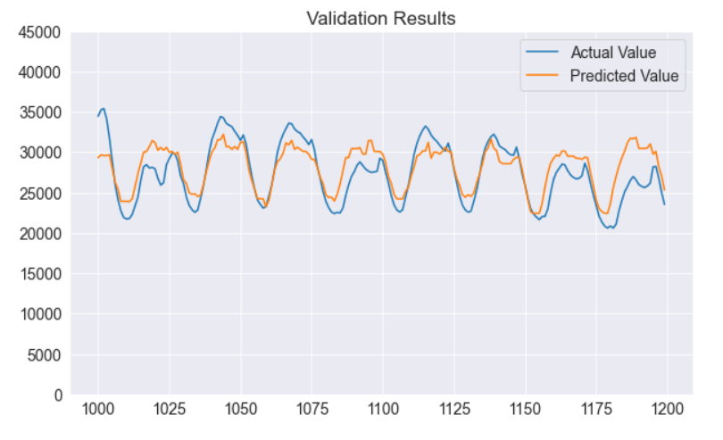
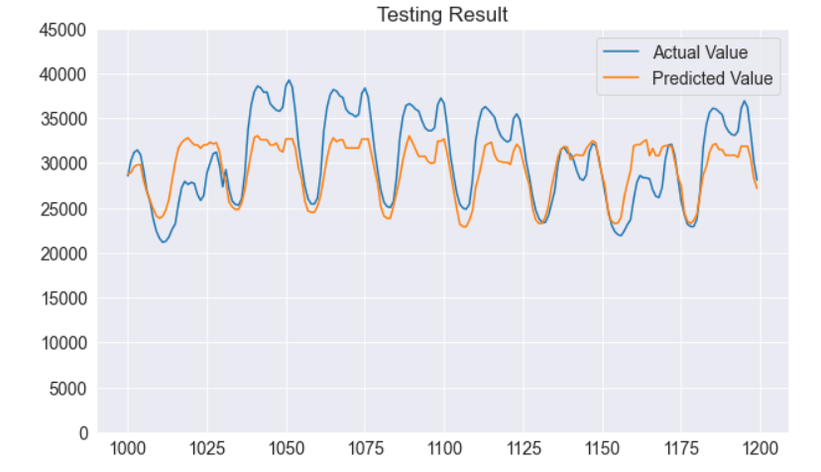
Checking Results With Validation and Test Set
Mean Absolute Deviation = 8.29%
Mean Absolute Deviation = 8.37%

Slide 18
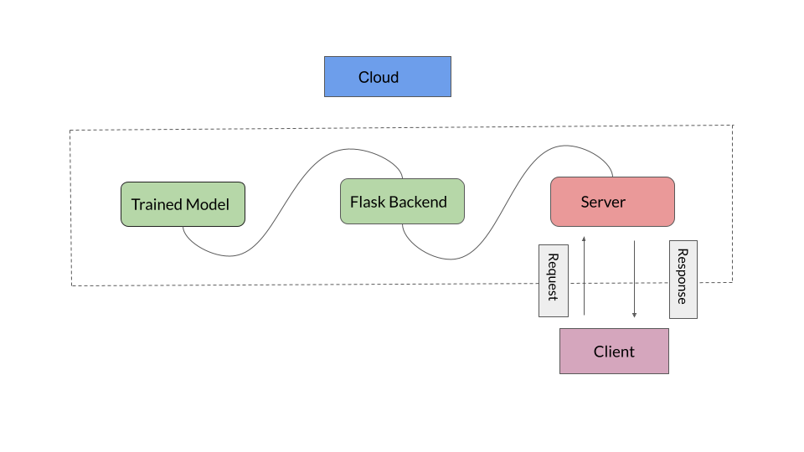
Deploying Model and Build Backend

Slide 19
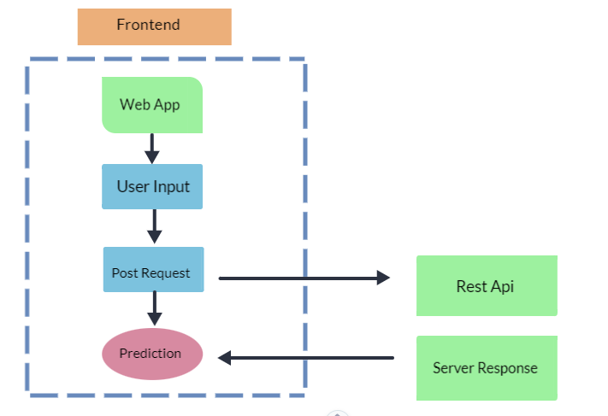
Work Flow to Deploy and Build Web App

Slide 20
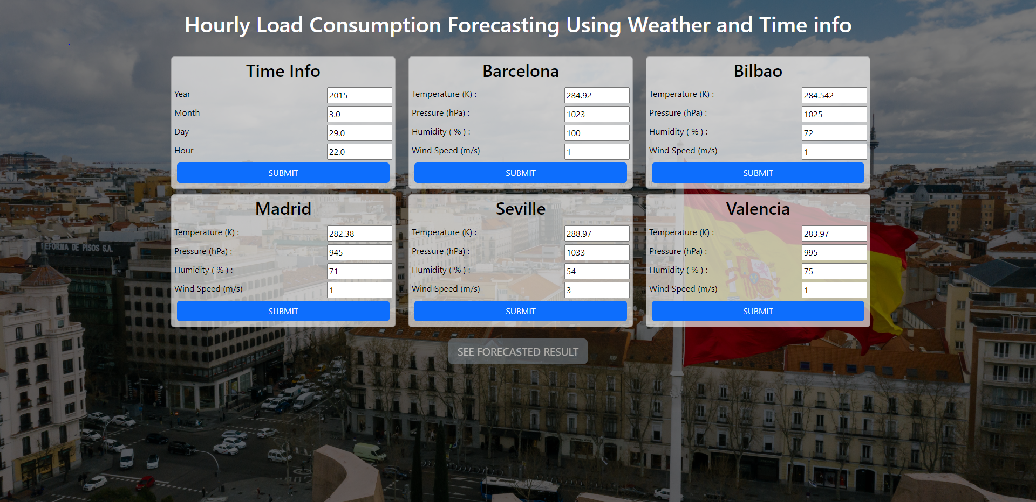
Demonstration of Web Application (User Input)

Slide 21

Demonstration of Web Application (Prediction)

Slide 22
THANK YOU

